Slide 1
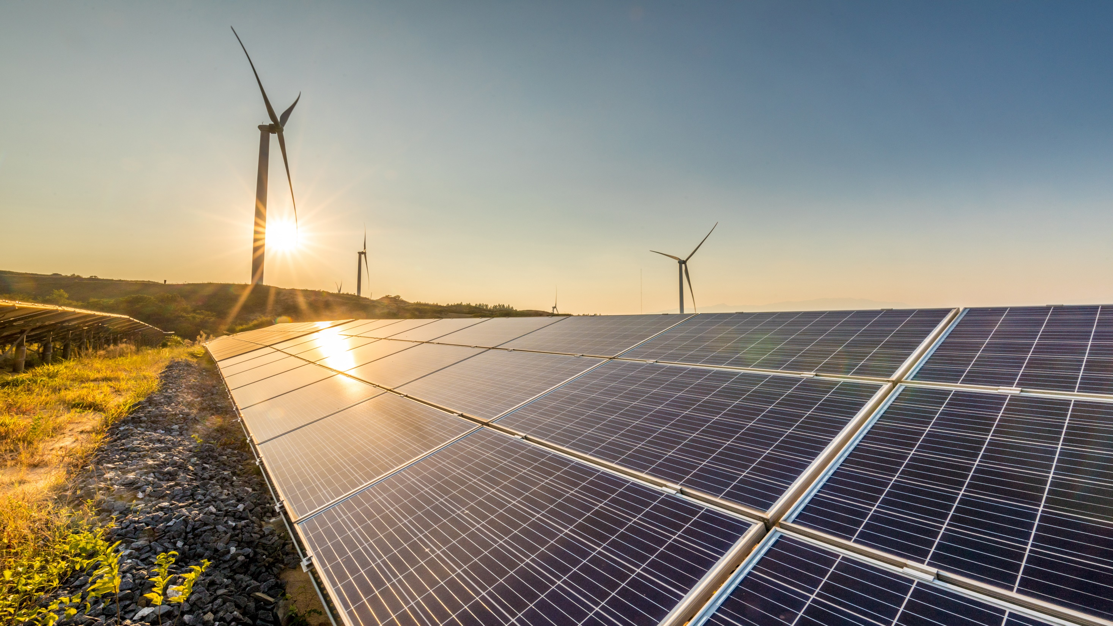




Introducing WPD’s Green Recovery Call for Evidence
westernpower.co.uk

Slide 2
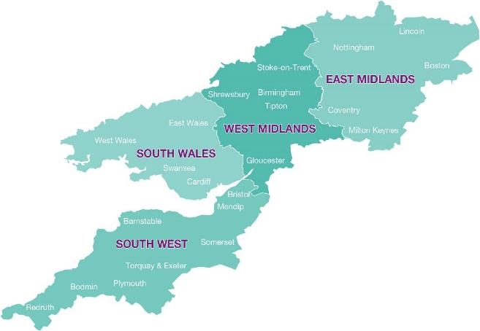
Who we are
We operate the local electricity network, distributing power to nearly 8 million homes & businesses
Covering the East and West Midlands, South Wales and South West England
Network assets
Cables and overhead lines | 225,000 km
Poles and towers | 1,389,000
Transformers | 188,000

Slide 3
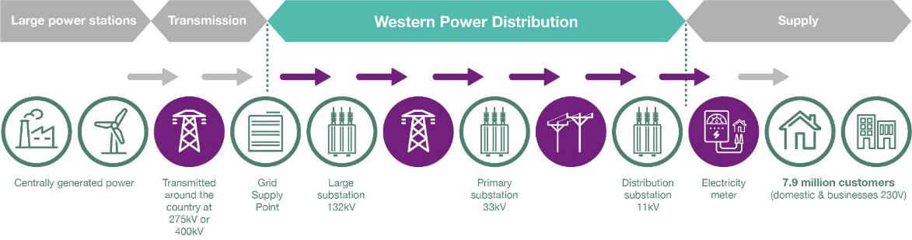
Who we are
A Distribution Network Operator (DNO)

Slide 4
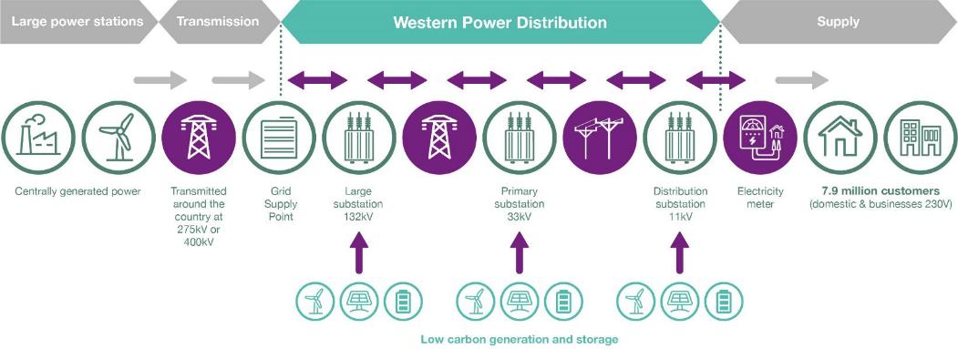
Who we are
Now including a Distribution System Operator (DSO)

Slide 5








What we do
Keep the lights on by operating our network assets effectively | Maintain equipment so that the network remains reliable | Fix the network if equipment gets damaged or is faulty | Connect customers by upgrading existing networks or building new ones | Operate a smart system by managing two-way power flows and flexibility services
westernpower.co.uk

Slide 6

Green recovery
Call for evidence launch
Working alongside Ofgem and industry, we have drawn up plans to unlock early investment in the network to boost green growth, jobs and support Net Zero.
From Monday 8th February, a 6-week call for evidence was launched.
All stakeholders and technologies invited to participate and submit details of their projects that are ready to connect to the network.
Evidence gathered to determine the sites to target investment based on core criteria:
  Utilisation (i.e. how much of the capacity might be used in the near term)
  Deliverability (i.e. how quickly infrastructure and solutions could be completed)
  Value for money (including wider societal benefits that can be achieved)

Slide 7
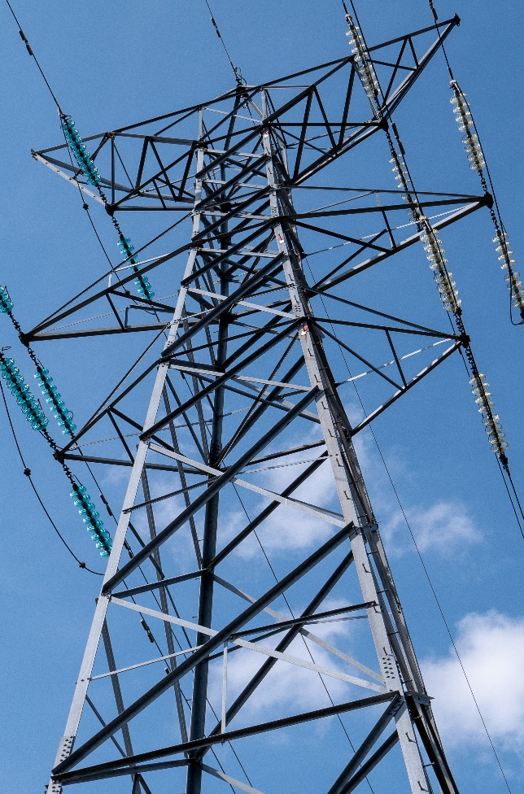
Green recovery
What is WPD offering?
Up to £20m network investment per licence area between now and 2023.
Investment will upgrade and build new electrical infrastructure and substations, enabling more green developments, such as electric vehicle chargers, mass heat pump installations and renewable generation (e.g. solar parks), to connect to the electricity network.
WPD has already identified areas where there is interest in low carbon technology projects and where some network restrictions exist. Investment will unlock additional capacity in the chosen areas or bring the network closer to where the third party interest is.
Customers seeking a connection will pay for their own sole-use connection assets and follow the normal connection application process.

Slide 8
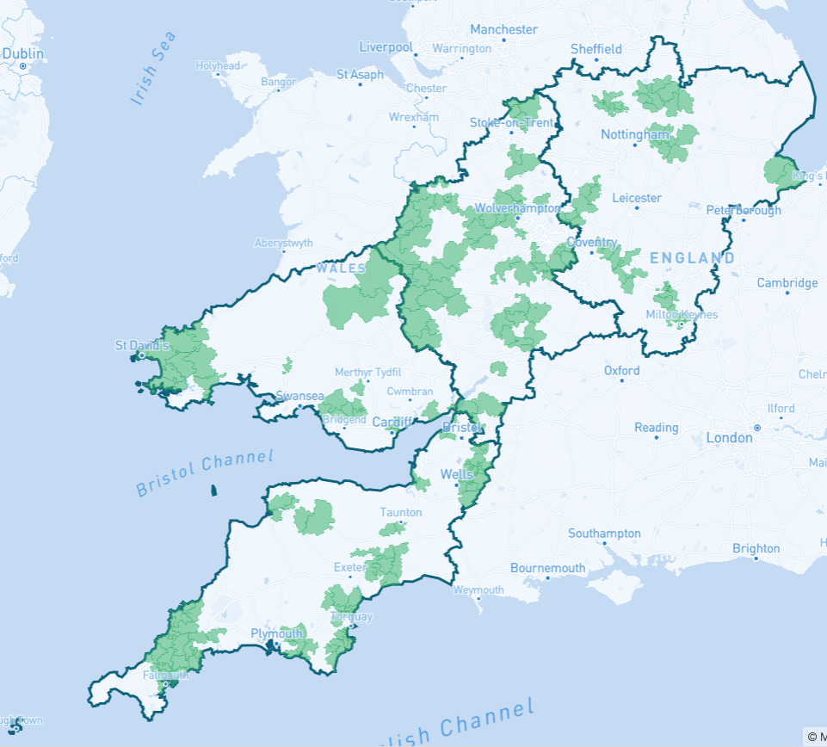
Green recovery map
Current view
The map shows areas where we have identified a potential need for strategic investment to enable green recovery projects over the next two years.
Reinforcement proposals vary but include new or upgraded substations (11kV, 33kV, 66kV and 132kV) and upgrading of existing circuits (underground and overhead)
Examples could include upgrading the local 11kV network in a town to facilitate a large number of commercial EV chargers or rebuilding an overhead electricity line / underground cable between two rural substations to enable renewable generation proposals in an area to connect.
Have we identified the right areas for investment?

Slide 9
How evidence will be assessed
Assessment of the evidence will follow the closure of the Call for Evidence window (19th March).
We have identified evaluation criteria that demonstrates what a model green recovery project achieves.
The more a project meets the different criteria, the more it will influence our investment plans.

Slide 10
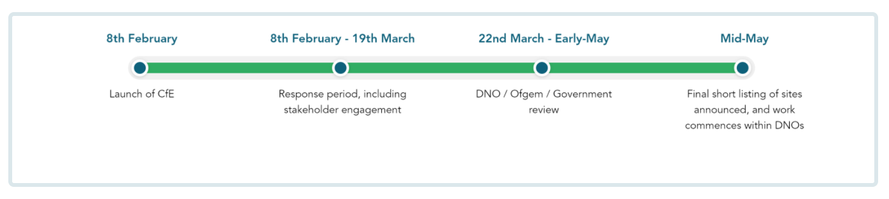
Green recovery
Timeline

Slide 11






What we’re asking you to do
www.westernpower.co.uk/green-recovery
Visit the website and complete the questionnaire to inform us on whether you agree with our highlighted areas or to send information on any areas we have missed.
Share information on any ‘green’ projects in those areas that are nearly ‘ready to go’
If you’re time-pressed, review our consultation document (67 core commitments)
How to respond to the call for evidence
You can submit your responses online. Please use this facility if you can, as it assists us during the analysis.
Alternatively you can download a response form and email or post this to us.
Visit:
www.westernpower.co.uk/green-recovery
Email:
wpdgreenrecovery@westernpower.co.uk
Write:
Green Recovery Call for Evidence, Corporate Communications, Western Power Distribution, Feeder Road, Bristol, BS2 0TB.
Closing date: Friday 19th March
westernpower.co.uk

Slide 12
ANY QUESTIONS?
Thank you very much for time and input into our process
westernpower.co.uk

Slide 13
www.westernpower.co.uk/green-recovery

